Slide 1


Slide 2
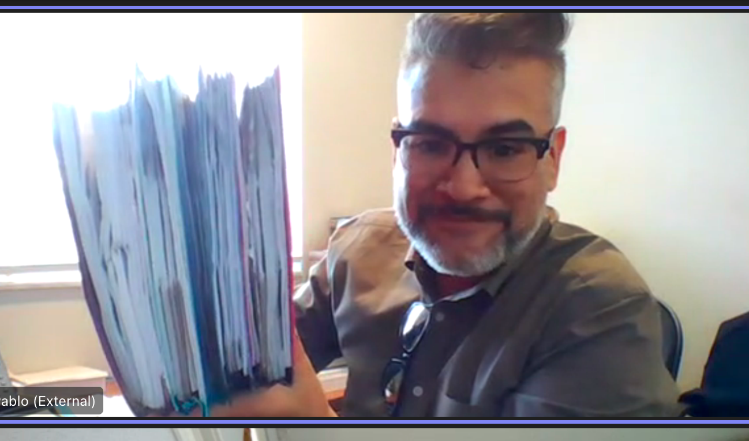

Body

Slide 3

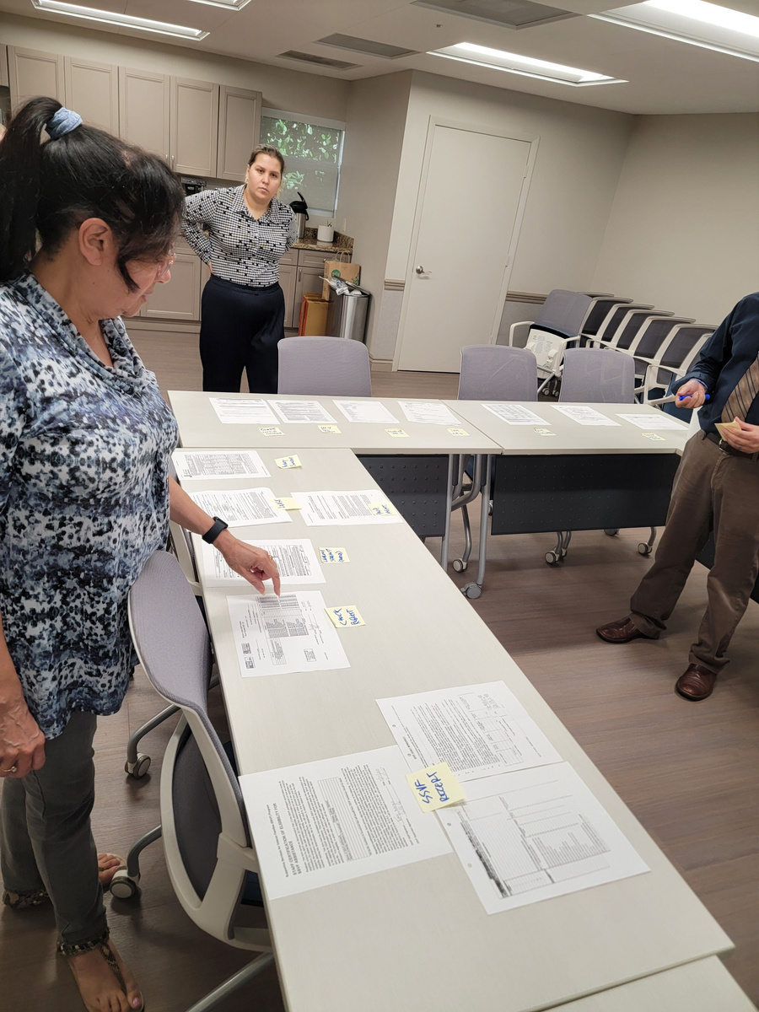
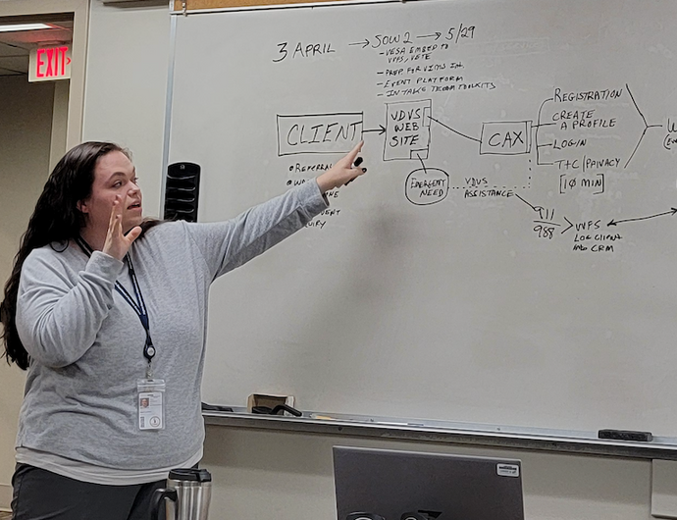
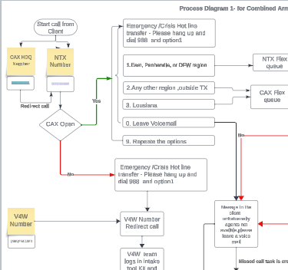

MODERNIZATION
Discovery
Process Improvement
Automation
Conduct landscape, business and tech gap analysis
Step-by-Step business process improvement
Drive efficiencies and productivity with automation

Slide 4










TRANSFORMING YOUR STATE
BUSINESS PROCESS
IMPROVEMENT
APPLICATION PROGRAM
INTERFACE
MOBILE APPLICATION
3RD PARTY SOFTWARE
INTEGRATIONS
BUSIENSS
INTELLIGENCE
DATA MIGRATION &
DATA BLENDING
PROCESS AUTOMATION
INTERDEPARTMENTAL
INTEGRATION

Slide 5
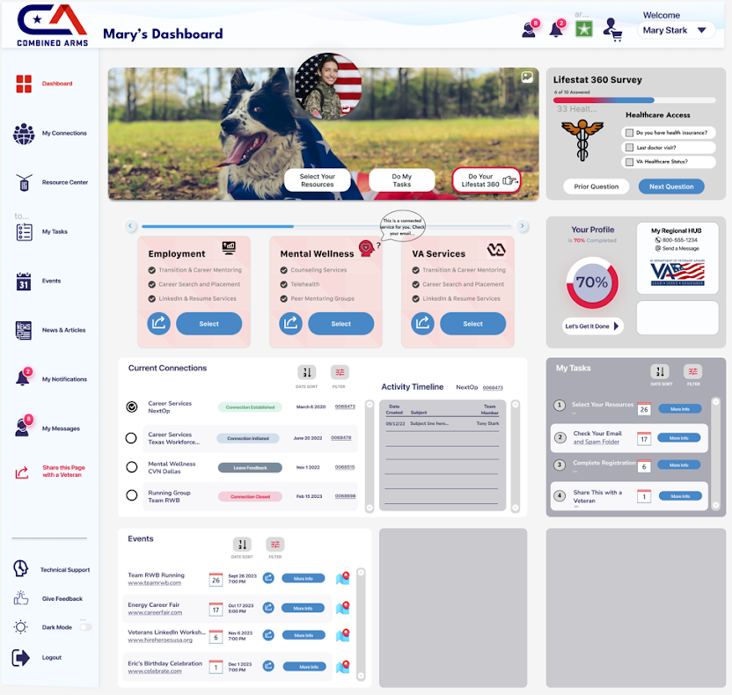

Slide 6
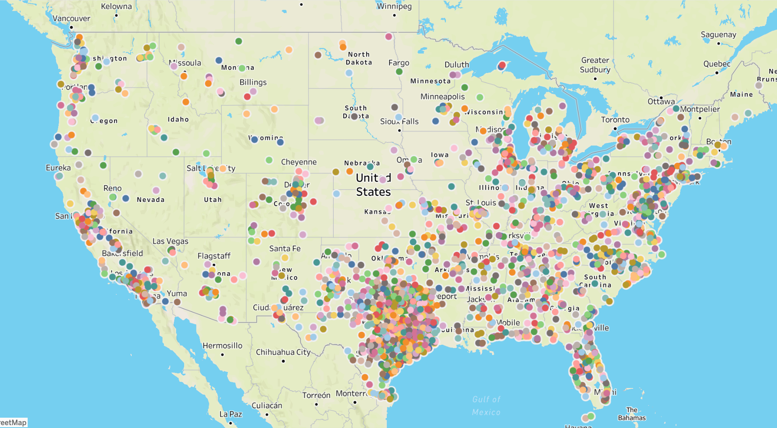


Slide 7
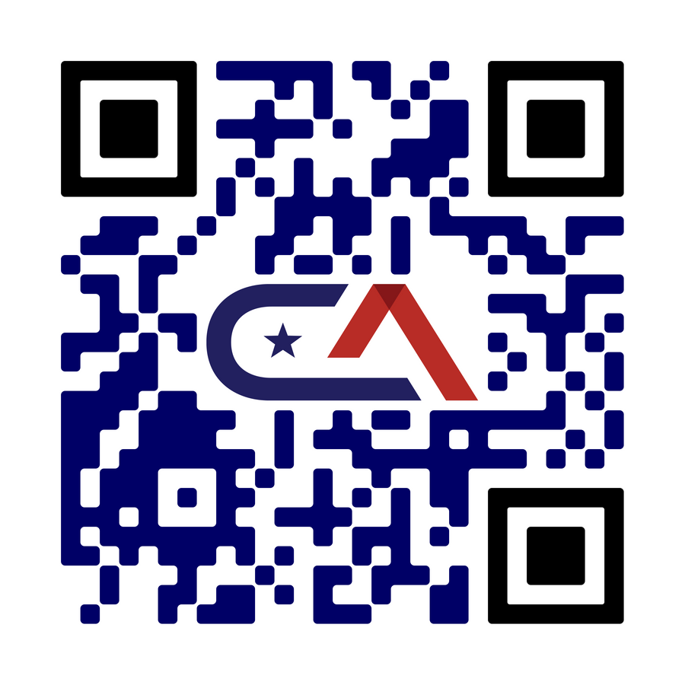
HOW CAN COMBINED ARMS
TRANSFORM THE FUTURE
OF TECHNOLOGY IN YOUR
STATE?

